Slide 1
Chapter 2: Design Patterns
What are design patterns?

Slide 2
Topics
What are design patterns?
Creational design patterns
Structural design patterns
Behavioral design patterns

Slide 3
Patterns
A common solution to a common problem in a given context
High level patterns for organizing software: architectural styles
Low level patterns for describing details :
Based on the level of detail, complexity, and scale of applicability to the entire system being design, design pattern can be either creational, structural or behavioral.

Slide 4
What is a Design pattern?
Each pattern Describes a problem which occurs over and over again in our environment ,and then describes the core of the problem
They are generally target at solving the problems of object generation and integration .
Novelists, playwrights and other writers rarely invent new stories.
Often ideas are reused, such as the “Tragic Hero” from Hamlet or Macbeth.
Designers reuse solutions also, preferably the “good” ones – Experience is what makes one an ‘expert’
Problems are addressed without rediscovering solutions from scratch. “My wheel is rounder.

Slide 5
Cont..
Design Patterns are the best solutions for the re-occurring problems in the application programming environment.
Responsible for design pattern analysis in other areas, including GUIs.
Mainly used in Object Oriented programming
Design patterns capture the best practices of experienced object-oriented software developers.
Design patterns are solutions to general software development problems.

Slide 6
Evolution of design patterns
The four authors of the book “elements of reusable Object-oriented Software ” are referred as Gang of Four are the ones who brought the concept of design patterns in their book as elements of reusable object-oriented software .
The book is divided in two parts with the first part explains the prons and cons of object oriented programming and second part explaining about the evolution of 23 classic software design patterns

Slide 7
What does the pattern consist of?
Most patterns are described very formally so people can reproduce them in many contexts. Here are the sections that are usually present in a pattern description:
Intent of the pattern briefly describes both the problem and the solution.
Motivation further explains the problem and the solution the pattern makes possible.
Structure of classes shows each part of the pattern and how they are related.
Code example in one of the popular programming languages makes it easier to grasp the idea behind the pattern.
all patterns can be categorized by their intent, or purpose

Slide 8
Types of patterns
Creational Patterns: are designed for class instantiation.
Provide object creation mechanisms that increase flexibility and reuse of existing code.
They can be either class-creation patterns or object-creational patterns
example Builder, factory, prototype, singleton…
Structural Patterns: designed with regard to a class's structure and composition.
explain how to assemble objects and classes into larger structures, while keeping these structures flexible and efficient.
example Adapter, bridge, composite, facade…

Slide 9
cont…
Behavioral Patterns: designed depending on how one class communicates with others.
take care of effective communication and the assignment of responsibilities between objects.
example Chain of Responsibility, Iterator, mediator Command, interpreter...
Design patterns Enable a designer to determine whether the pattern:
Is applicable to the current work
Can be reused
Can serve as a guide for developing a similar but functionally or structurally different pattern

Slide 10
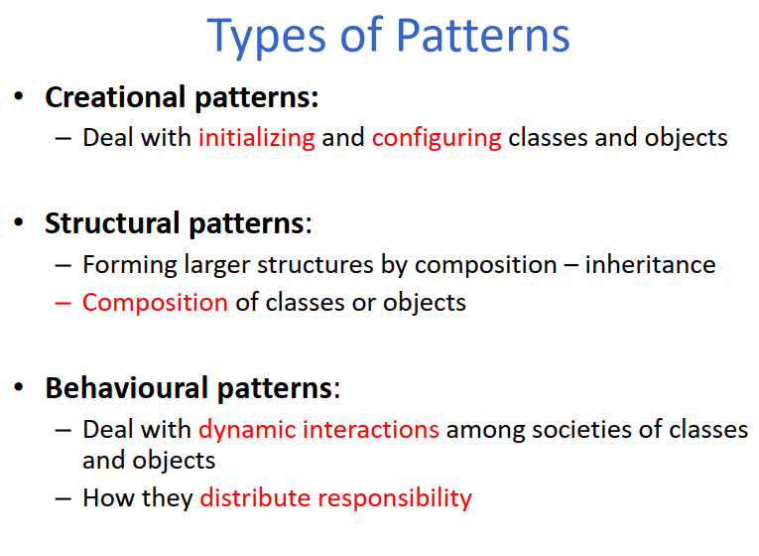

Slide 11
 | Creational | Structural | Behavioral
Class | Factory Method | Adapter (class) | Interpreter Template Method
Object | Abstract Factory Builder Prototype Singleton | Adapter (object) Bridge Composite Decorator Facade Flyweight Proxy | Chain of Responsibility Command Iterator Mediator Memento Observer State Strategy Visitor

Slide 12
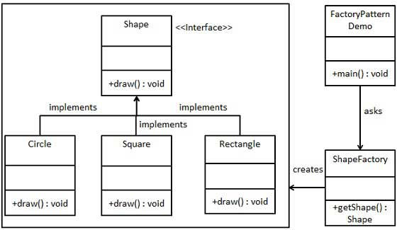
Creational patterns
These patterns have to do with how objects are instantiated into memory, typically in an attempt to simplify their creation.
1. Factory Design Pattern: is a creational design pattern that provides an interface for creating objects in a superclass, but allows subclasses to alter the type of objects that will be created.
Groups together multiple object factories that have a common theme.
create a Shape interface and concrete classes implementing the Shape interface. A factory class ShapeFactory is defined as a next step.

Slide 13
Cont..
2. Builder Pattern builds a complex object using simple objects and using a step by step approach.
The pattern allows you to produce different types and representations of an object using the same construction code.
Create an interface Item representing food item and packing.

Slide 14
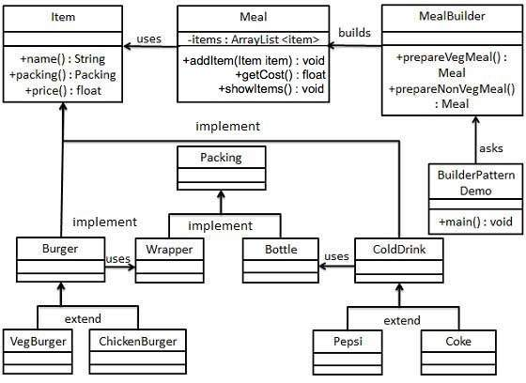
Cont..

Slide 15
Cont..
3. Singleton Pattern: Restricts object creation for a class to only one instance.
This pattern involves a single class which is responsible to create an object while making sure that only single object gets created. This class provides a way to access its only object which can be accessed directly without need to instantiate the object of the class.
We're going to create a SingleObject class. SingleObject class have its constructor as private and have a static instance of itself.

Slide 16
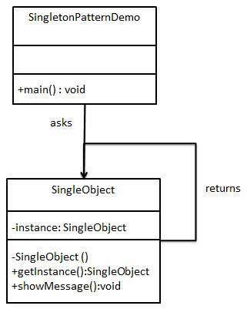
Cont..
SingleObject class provides a static method to get its static instance to outside world. SingletonPatternDemo, our demo class will use SingleObject class to get a SingleObject object.

Slide 17
Structural Patterns
Structural patterns describe how classes and objects can be combined to form larger structures.
The Structural patterns are:
Adapter
Façade

Slide 18
Adapter Pattern
Adapter pattern works as a connector between two incompatible interfaces.
This type of design pattern comes under structural pattern as this pattern combines the capability of two independent interfaces.
This pattern involves a single class which is responsible to join functionalities of independent or incompatible interfaces.
A real life example could be a case of card reader which acts as an adapter between memory card and a laptop.
You plug-in the memory card into card reader and card reader into the laptop so that memory card can be read via laptop.

Slide 19
Contd..
We have a MediaPlayer interface and a concrete class Audio Player implementing the Media Player interface.
Audio Player can play mp3 format audio files by default.
We are having another interface AdvancedMediaPlayer and concrete classes implementing the AdvancedMediaPlayer interface.
These classes can play vlc and mp4 format files.
We want to make AudioPlayer to play other formats as well.
To attain this, we have created an adapter class MediaAdapter which implements the MediaPlayer interface and uses AdvancedMediaPlayer objects to play the required format.
AudioPlayer uses the adapter class MediaAdapter passing it the desired audio type without knowing the actual class which can play the desired format.
AdapterPatternDemo, our demo class, will use AudioPlayer class to play various formats.

Slide 20
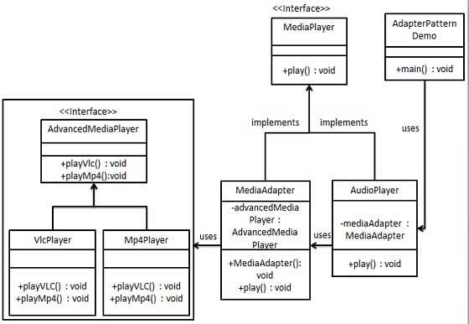
Contd..

Slide 21
Contd..
public interface MediaPlayer {
public void play(String audioType, String fileName);
}
public interface AdvancedMediaPlayer {
public void playVlc(String fileName);
public void playMp4(String fileName);
}
public class VlcPlayer implements AdvancedMediaPlayer{
public void playVlc(String fileName) {
System.out.println("Playing vlc file. Name: "+ fileName);
}
public void playMp4(String fileName) {
//do nothing
}
}

Slide 22
Cont..
public class Mp4Player implements AdvancedMediaPlayer{
public void playVlc(String fileName) {
//do nothing
}
public void playMp4(String fileName) {
System.out.println("Playing mp4 file. Name: "+ fileName);
}
}

Slide 23
Contd..
public class MediaAdapter implements MediaPlayer {
AdvancedMediaPlayer advancedMusicPlayer;
public MediaAdapter(String audioType){
if(audioType.equalsIgnoreCase("vlc") ){
advancedMusicPlayer = new VlcPlayer();
} else if (audioType.equalsIgnoreCase("mp4")){
advancedMusicPlayer = new Mp4Player();
}
}
public void play(String audioType, String fileName) {
if(audioType.equalsIgnoreCase("vlc")){
advancedMusicPlayer.playVlc(fileName);
}else if(audioType.equalsIgnoreCase("mp4")){
advancedMusicPlayer.playMp4(fileName);
}
}
}

Slide 24
Contd..
public class AudioPlayer implements MediaPlayer {
MediaAdapter mediaAdapter;
public void play(String audioType, String fileName) {
if(audioType.equalsIgnoreCase("mp3")){
System.out.println("Playing mp3 file. Name: "+ fileName);
}
//mediaAdapter is providing support to play other file formats
else if(audioType.equalsIgnoreCase("vlc") || audioType.equalsIgnoreCase("mp4")){
mediaAdapter = new MediaAdapter(audioType);
mediaAdapter.play(audioType, fileName);
}
else{
System.out.println("Invalid media. "+
audioType + " format not supported");
} }
}

Slide 25
Facade Pattern
Facade pattern hides the complexities of the system and provides an interface to the client using which the client can access the system.
This type of design pattern comes under structural pattern as this pattern adds an interface to existing system to hide its complexities.
This pattern involves a single class which provides simplified methods required by client and delegates calls to methods of existing system classes.
We are going to create a Shape interface and concrete classes implementing the Shape interface. A facade class ShapeMaker is defined as a next step.
ShapeMaker class uses the concrete classes to delegate user calls to these classes. FacadePatternDemo, our demo class, will use ShapeMaker class to show the results.

Slide 26
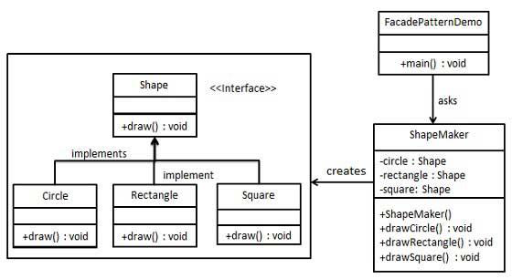
Contd..

Slide 27
Contd...
public interface Shape {
void draw();
}
public class Rectangle implements Shape {
public void draw() {
System.out.println("Inside Rectangle::draw() method."); }
}
public class Circle implements Shape {
public void draw() {
System.out.println("Inside Circle::draw() method."); }
}
public class Square implements Shape {
public void draw() {
System.out.println("Inside Square::draw() method."); }
}

Slide 28
Contd...
public class ShapeMaker {
private Shape circle;
private Shape rectangle;
private Shape square;
public ShapeMaker() {
circle = new Circle();
rectangle = new Rectangle();
square = new Square();
}
public void drawCircle(){
circle.draw(); }
public void drawRectangle(){
rectangle.draw(); }
public void drawSquare(){
square.draw(); }
}

Slide 29
Contd...
public class Client {
public static void main(String[] args)
{
ShapeMaker shapeMaker = new ShapeMaker();
shapeMaker.drawCircle();
shapeMaker.drawRectangle();
shapeMaker.drawSquare();
}
}

Slide 30
Behavioral Design Patterns
Behavioral design patterns help you define the communication between objects in your system and how the flow is controlled in a complex program.
The behavioral patterns are:
Iterator
Chain of Responsibility

Slide 31
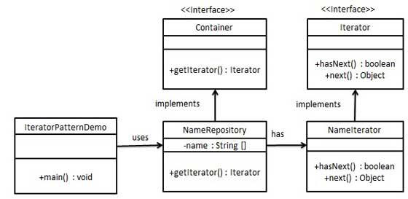
Iterator Pattern
An aggregate object such as a list should give you a way to access its elements without exposing its internal structure.
The key idea is to take the responsibility for access and traversal out of the list object and put it into an iterator object.
This pattern is used to get a way to access the elements of a collection object in sequential manner without any need to know its underlying representation.

Slide 32
Contd..
public interface Iterator {
public boolean hasNext();
public Object next();
}
public interface Container {
public Iterator getIterator();
}
public class NameRepository implements Container {
public String names[] = {"Robert" , "John" ,"Julie" , "Lora"};
public Iterator getIterator() {
return new NameIterator();
}

Slide 33
Contd..
private class NameIterator implements Iterator {
int index;
public boolean hasNext() {
if(index < names.length){
return true;
}
return false;
}
public Object next() {
if(this.hasNext()){
return names[index++];
}
return null;
}
} }

Slide 34
Chain of Responsibility
Chain of responsibility pattern creates a chain of receiver objects for a request.
This pattern decouples sender and receiver of a request based on type of request.
In this pattern, normally each receiver contains reference to another receiver.
If one object cannot handle the request then it passes the same to the next receiver and so on.
Chain of Responsibility allows a number of classes to attempt to handle a request, independently of any other object along the chain.
Once the request is handled, it completes it's journey through the chain.
We have created an abstract class AbstractLogger with a level of logging. Then we have created three types of loggers extending the AbstractLogger. Each logger checks the level of message to its level and print accordingly otherwise does not print and pass the message to its next logger.

Slide 35
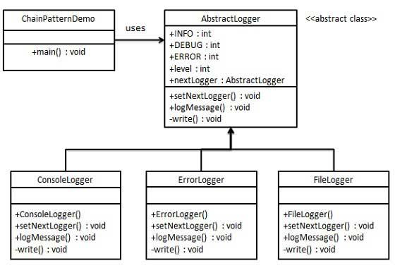
Contd..

Slide 36
Chain of Responsibility
public abstract class AbstractLogger {
public static int INFO = 1; public static int DEBUG = 2;
public static int ERROR = 3; protected int level;
//next element in chain or responsibility
protected AbstractLogger nextLogger;
public void setNextLogger(AbstractLogger nextLogger){
this.nextLogger = nextLogger;
}
public void logMessage(int level, String message){
if(this.level <= level){
write(message);
}
if(nextLogger !=null){
nextLogger.logMessage(level, message);
} }
abstract protected void write(String message);
}

Slide 37
Chain of Responsibility
public class ConsoleLogger extends AbstractLogger {
public ConsoleLogger(int level){
this.level = level;
}
protected void write(String message) {
System.out.println("Standard Console::Logger: " + message);
}}
public class ErrorLogger extends AbstractLogger {
public ErrorLogger(int level){
this.level = level;
}
protected void write(String message) {
System.out.println("Error Console::Logger: " + message);
}
}

Slide 38
Chain of Responsibility
public class FileLogger extends AbstractLogger {
public FileLogger(int level){
this.level = level;
}
protected void write(String message) {
System.out.println("File::Logger: " + message);
}
}

Slide 39
Chain of Responsibility
public class ChainPatternDemo {
private static AbstractLogger getChainOfLoggers(){
AbstractLogger errorLogger = new ErrorLogger(AbstractLogger.ERROR);
AbstractLogger fileLogger = new FileLogger(AbstractLogger.DEBUG);
AbstractLogger consoleLogger = new ConsoleLogger(AbstractLogger.INFO);
errorLogger.setNextLogger(fileLogger);
fileLogger.setNextLogger(consoleLogger);
return errorLogger;
}
public static void main(String[] args) {
AbstractLogger loggerChain = getChainOfLoggers();
loggerChain.logMessage(AbstractLogger.INFO, "This is an information.");
loggerChain.logMessage(AbstractLogger.DEBUG,
"This is a debug level information.");
loggerChain.logMessage(AbstractLogger.ERROR, "This is an error information.");
} }

Slide 40
Design Model
Data design: This specifies the data structures for implementing the software by converting data objects and their relationships identified during the analysis phase.
Architectural design: This specifies the relationship between the structural elements of the software, design patterns, architectural styles
Component-level design: This provides the detailed description of how structural elements of software will actually be implemented.
Interface design: This depicts how the software communicates with the system that interoperates with it and with the end-users.

Slide 41
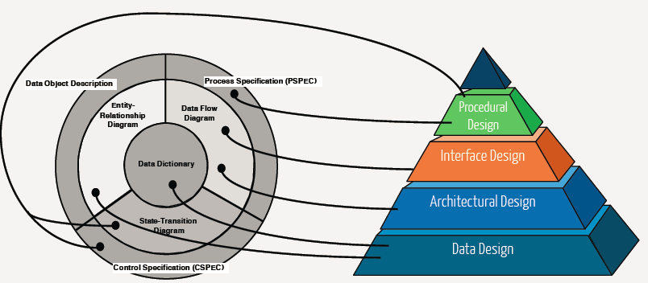
Analysis to Design Model

Slide 42
Design Methodologies
A more methodical approach to software design is proposed by structured methods which are sets of notations and guidelines for software design,
There are two major rules of this method
Programs were to be broken into functions and subroutines.
There was only a single entry point and a single exit point for any function or routine.
Structured methods often support some or all of the following models of a system:
• A data-flow model
• An Entity-relationship model
• A structural model
• An object-oriented model

Slide 43
Structured Design
Structured design is a conceptualization of problem into several well organized elements of solution.
Structured design is mostly based on ‘divide and conquer’ strategy where a problem is broken into several small problems and each small problem is individually solved until the whole problem is solved.
A good structured design always follows some rules for communication among multiple modules, namely -
• Cohesion - grouping of all functionally related elements.
• Coupling - communication between different modules.
A good structured design has high cohesion and low coupling arrangements.

Slide 44
Function Oriented Design
Function oriented design inherits some properties of structured design where divide and conquer methodology is used.
In function-oriented design, the system is comprised of many smaller sub-systems known as functions.
The basic abstractions, which are given to the user, are real world functions.
This design mechanism divides the whole system into smaller functions, which provides means of abstraction by concealing the information and their operation.
It views system as Black Box that performs high level function and later decompose it detailed function so to be mapped to modules.
Function oriented design works well where the system state does not matter and program/functions work on input rather than on a state.

Slide 45
Object Oriented Design
Object oriented design works around the entities and their characteristics instead of functions involved in the software system.
This design strategies focuses on entities and its characteristics. The whole concept of software solution revolves around the engaged entities.
All entities involved in the solution design are known as objects.
In the solution design, attributes are stored as variables and functionalities are defined by means of methods or procedures.
OOD allows similar classes to stack up in hierarchical manner where the lower or sub-classes can import, implement and re-use allowed variables and methods from their immediate super classes.
Depending upon how the function is invoked, respective portion of the code gets executed.

Slide 46

Thank You!

